Slide 1
Soldering Workshop
Led by Ethan Tabler

Slide 2
What is solder and why do we use it?

Slide 3
Solder is...
Metal
Several types of metal, typically alloyed
Lead vs lead-free
Flux
Rosin flux helps the mechanical strength and electrical contact of electrical joints
More permanent
Breadboards are for quick testing
Soldered circuits are sturdy and more reliable
Notes:
Why do we use solder?

Slide 4
Solder can be used to...
Electrically connect components
Conductive
Can be used in place of wiring
Mechanically connect components
Strength varies with alloy/mix
Take a look at your potentiometers!
What about non-electrical uses?

Slide 5
What other tools might be helpful?
Solder wick
Tweezers
Solder sucker
Wire cutters
Wet sponge
Silicone Pad
Tip cleaner (brass)
Wire stripper
Microscope
Helping Hand
Notes:
Solder wick, Tweezers, Solder sucker, Wire cutters, Wet sponge, Silicone Pad, Tip cleaner (brass), Wire stripper, Microscope, Helping Hand

Slide 6
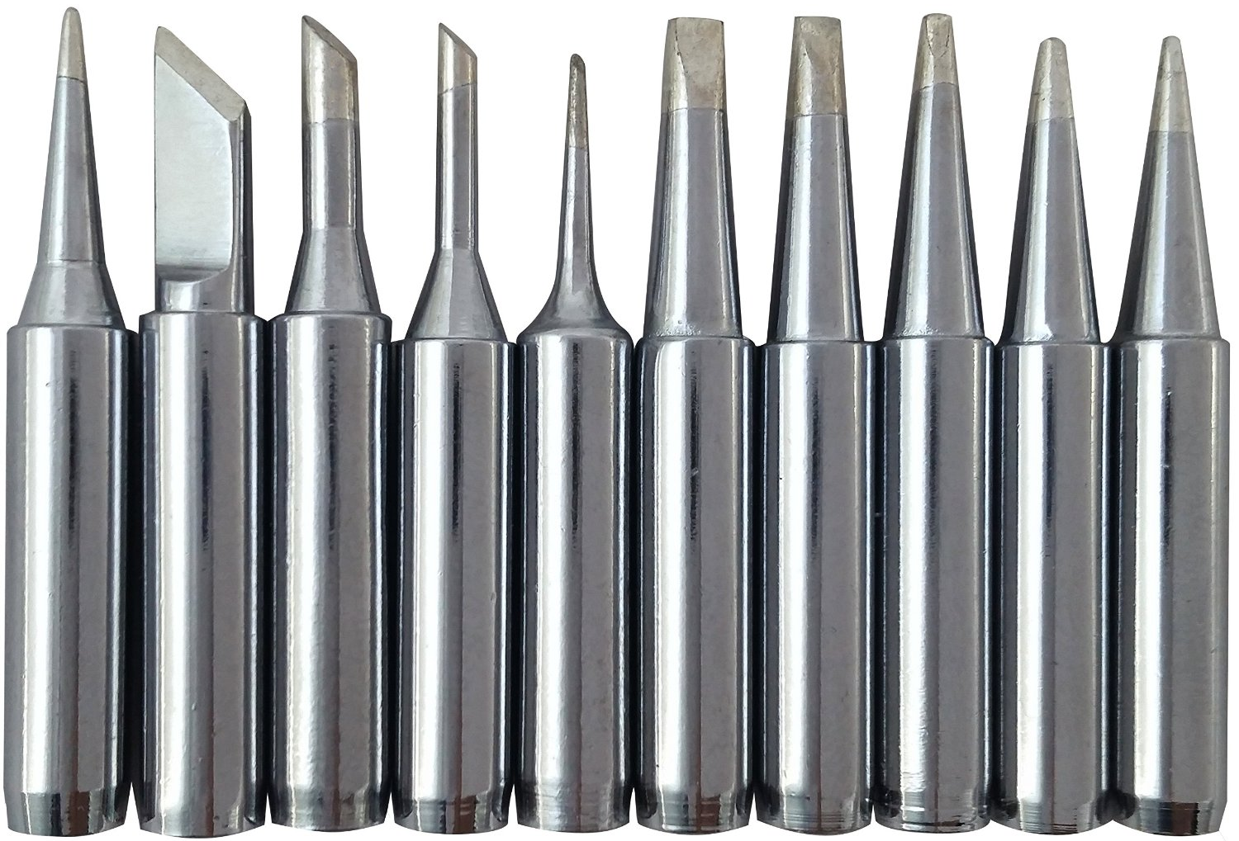
Soldering Iron Tips
Different tips are used for specific purposes
Finer tips are used for SMD parts and smaller TH devices
Thicker, wedge-shaped tips are used for larger components or mechanical joints
Larger tips have more thermal mass and can melt solder faster

Slide 7
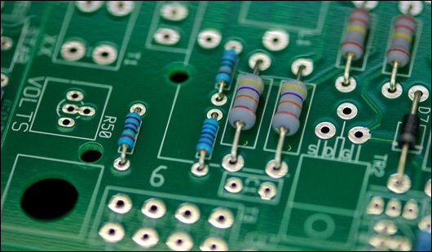
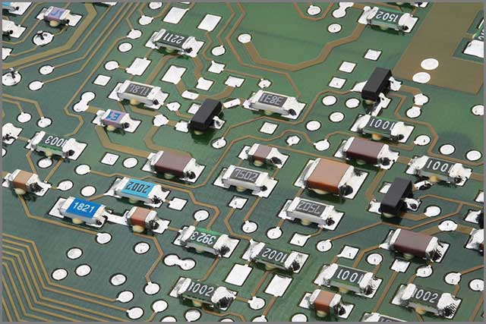
Through-Hole
Surface-Mount
Part physically goes through the board; easier to solder
Only mounted on one side of the board; harder to solder

Slide 8
Demonstration
Notes:
Perfboard with 2 resistors per person, solder bridging → (smaller components first) through-hole on PCB, SMD cap → Will/jackie does speaker/battery; Ethan does hot air solder for SOIC → finish with potentiometer
Option of solder sucker/solder wick at the end

